Slide 1

E-COMMERCE BUSINESS PERFORMANCE ANALYSIS
Awalsyah Rinanto Putra
Data Enthusiast

Slide 2

TABLE OF CONTENTS
03
01
02
04
Annual Product Category Quality Analysis
Data Preparation and ERD
Annual Customer Activity Growth Analysis
Annual Payment Type Usage Analysis

Slide 3

01
Data Preparation and ERD

Slide 4

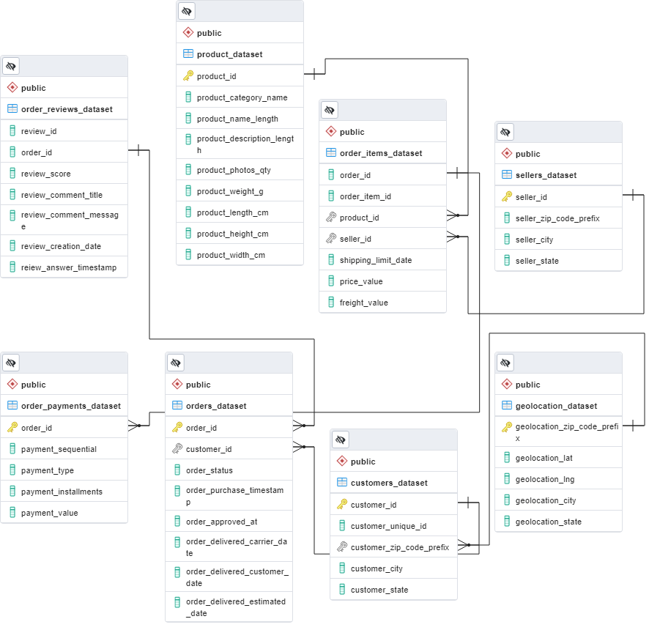
Entity Relationship Diagrams
4 primary keys:
Order_id in orders_dataset
Geolocation_zip_code_prefix in geolocation_dataset
Seller_id in sellers_dataset
Product_id in product_dataset
Those primary keys also become foreign key in other tables as we can see in ERD.

Slide 5
02
Annual Customer Activity Growth Analysis

Slide 6
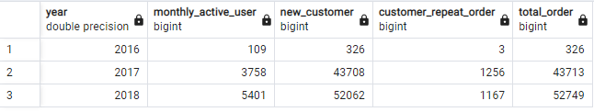
Table of Analysis
4 aspects of analysis:
Annual Monthly Active User
Annual New Customer
Annual Customer Repeat Order
Annual Customer Order

Slide 7
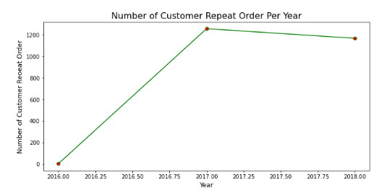
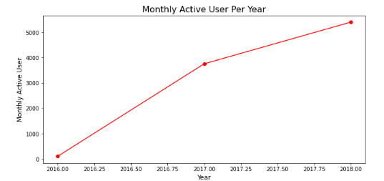
PostGreSQL Visualization
The annual customer repeat order highly increasing in 2017 but then decreased in 2018.
Company needs to find the what’s the root cause to fix the problem.
The annual monthly active user relatively have constant growing over the years. This is a good progress.

Slide 8
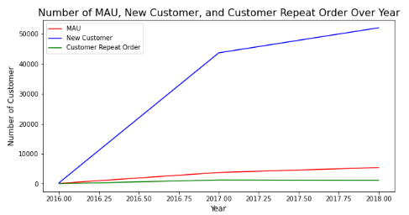
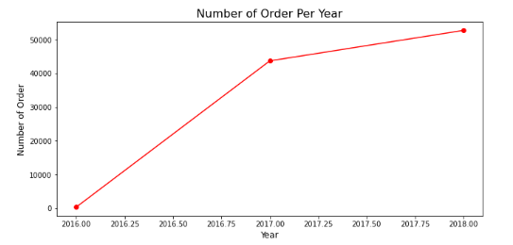
PostGreSQL Visualization
There’s highly increasing annual new customer (left chart) and annual number of order (right chart) over the year.
Those 2 line charts (annual new customer and annual number of order) have almost identical line chart pattern. It means these 2 metrics have very high correlation. In order to increase the number of order we can try to increase the number of new customer first.

Slide 9
03
Product Category Quality Growth Analysis

Slide 10
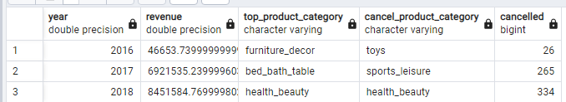
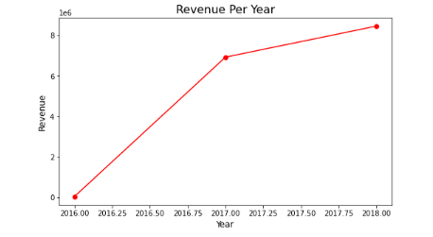
Table of Analysis and PostgreSQL Visualization
3 key important takes:
Revenue of the company have growing over the year.
The number of cancelled order also have increasing over the year, the company needs to find the solution.
Health beauty product is one of the top product category but also one of the top cancelled product category, company needs to investigate why this phenomenon happened.

Slide 11
04
Payment Type Usage Analysis

Slide 12
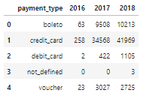
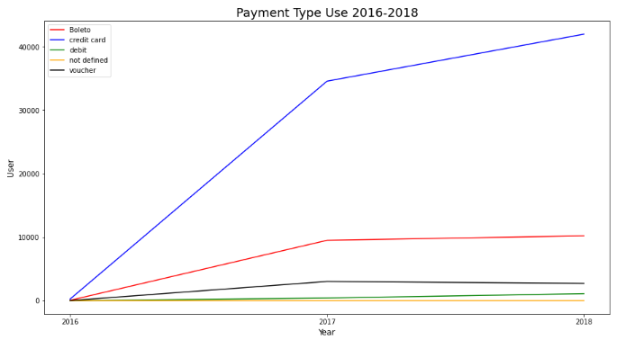
Table of Analysis and PostgreSQL Visualization
Credit card is the most-used payment type. The gap with the other payment method is relatively too much.
Company can make a programe or promotion to push the usage of other payment method by customer other than credit card to generate more revenue

Slide 13

THANK YOU!
SQL Query and the dataset can be accessed at github: Awalsyah1995
click here!
Do you have any questions?
awalsyahrinantoputra@gmail.com
+6281 1393 2861
LinkedIn: Awalsyah Rinanto Putra

